Slide 1

Non Verbal communication

Slide 2

What is this person feeling? Anger/Contempt/Amusement/

Slide 3
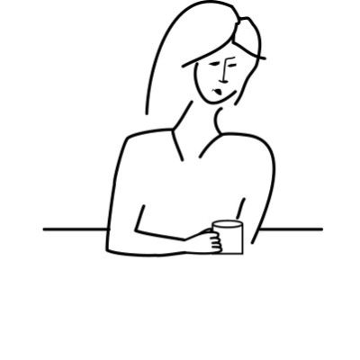
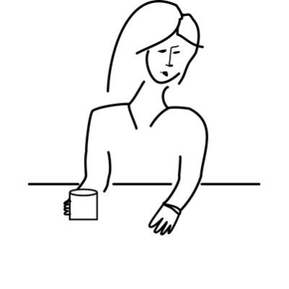
Which woman is more open to your ideas?

Slide 4
1. If someone leans toward you when they say something,
They like the smell of your perfume.
They are trying to see you better.
They are emphasizing a point.
2. When we feel an emotion it shows on our face. Is the opposite true? If we mimic a facial expression, will we feel the emotion associated with the expression?
Yes or No
3. If someone’s verbal message is out of alignment with their nonverbal message (body language and voice tone) science has shown that we believe their nonverbal message. How much weight do we give someone’s nonverbal signals?
Non verbal signals are twice as powerful as words.
Non verbal signals are six times as powerful as words.
Non verbal signals are twelve times as powerful as words.
4. Imagine that you walk into a room for an interview, shake the interviewer’s hand, sit down, and proceed with the interview. When do you make your first impression?
Between the door and when you have taken your seat.
After they have asked you three questions.

Slide 5
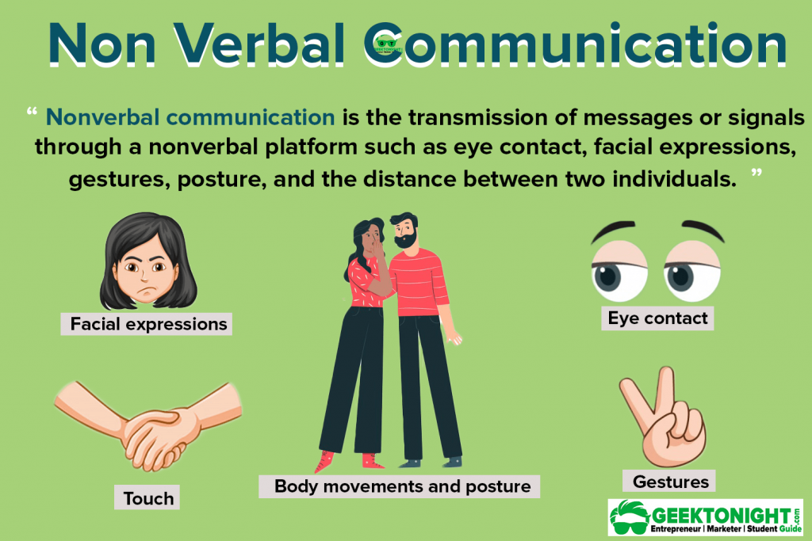

Slide 6
Communication channel is the sensory route on which a message travels.
Oral communication only relies on one channel, because spoken language is transmitted through sound and picked up by our ears.
Nonverbal communication, on the other hand, can be taken in by all five of our senses.
But we can also receive messages and generate meaning through touch, taste, and smell.
Touch is an especially powerful form of nonverbal communication. but we will not get into taste and smell, which have not received as much scholarly attention in relation to nonverbal communication as the other senses.
When we interact with others, we continuously send & receive signals.

Slide 7
Albert Mehrabian
Professor Mehrabian (1939-) believes that there are three core elements in the effective face-to-face communication of emotions or attitudes: nonverbal behaviour (facial expressions, for example), tone of voice, and the literal meaning of the spoken word. These three essential elements, Mehrabian argues, account for how we convey our liking, or disliking, of another person. His particular focus is on the importance of such nonverbal ‘clues’ when they appear to conflict with the words used and/or the tone in which they are spoken. Mehrabian developed his early theories on this subject during the 1960s. Drawing on the findings of two experiments he conducted in 1967, he formulated the 7-38-55% communication rule.

Slide 8
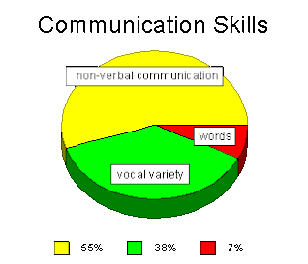
Non –Verbal communication
According to Albert Mehrabian 55% of the messages received & processed by the brain are based on the body language, 38% are based on tone of voice & only 7% of the received meaning is based on the words.

Slide 9
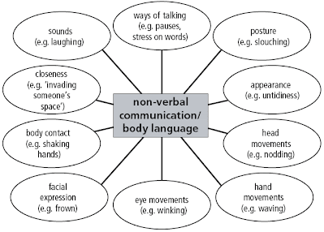

Slide 10
Categories and Features
G. W. Porter divides non-verbal communication into four broad categories:
Physical. This is the personal type of communication. It includes facial expressions, tone of voice, sense of touch, sense of smell, and body motions.
Aesthetic. This is the type of communication that takes place through creative expressions: playing instrumental music, dancing, painting and sculpturing.
Signs. This is the mechanical type of communication, which includes the use of signal flags, the 21-gun salute, horns, and sirens.
Symbolic. This is the type of communication that makes use of religious, status, or ego-building symbols.

Slide 11
Features
Static Features
Distance.
Distance. The distance one stands from another frequently conveys a non-verbal message. In some cultures it is a sign of attraction, while in others it may reflect status or the intensity of the exchange.
Orientation. People may present themselves in various ways: face-to-face, side-to-side, or even back-to-back. For example, cooperating people are likely to sit side-by-side while competitors frequently face one another.
Posture. Obviously one can be lying down, seated, or standing. These are not the elements of posture that convey messages. Are we slouched or erect ? Are our legs crossed or our arms folded ? Such postures convey a degree of formality and the degree of relaxation in the communication exchange.
Physical Contact. Shaking hands, touching, holding, embracing, pushing, or patting on the back all convey messages. They reflect an element of intimacy or a feeling of (or lack of) attraction

Slide 12
Dynamic Features
Facial Expressions.
Facial Expressions. A smile, frown, raised eyebrow, yawn, and sneer all convey information. Facial expressions continually change during interaction and are monitored constantly by the recipient. There is evidence that the meaning of these expressions may be similar across cultures.
Gestures. One of the most frequently observed, but least understood, cues is a hand movement. Most people use hand movements regularly when talking. While some gestures (e.g., a clenched fist) have universal meanings, most of the others are individually learned and idiosyncratic.
Looking. A major feature of social communication is eye contact. It can convey emotion, signal when to talk or finish, or aversion. The frequency of contact may suggest either interest or boredom.
The above list shows that both static features and dynamic features transmit important information from the sender to the receiver.

Slide 13
Kinesics
Forward and Backward Movements. If you extend a hand straight forward during an interview or tend to lean forward, Lamb considers you to be an "operator"- good for an organization requiring an infusion of energy or dramatic change of course.
Vertical Movements. If you tend to draw yourself up to your tallest during the handshake, Lamb considers you to be a "presenter." You are a master at selling yourself or the organization in which you are employed.
Side-to-Side Movements. If you take a lot of space while talking by moving your arms about, you are a good informer and good listener. You are best suited for an organization seeking a better sense of direction. Lamb believes there is a relationship between positioning of the body and movements of the limbs and facial expressions.

Slide 14
Tactile Communication
Communication through touch is obviously non-verbal. Used properly it can create a more direct message than dozens of words; used improperly it can build barriers and cause mistrust. You can easily invade someone's space through this type of communication. If it is used reciprocally, it indicates solidarity; if not used reciprocally, it tends to indicate differences in status. Touch not only facilitates the sending of the message, but the emotional impact of the message as well.
Personal Space
Personal space is your "bubble" - the space you place between yourself and others. This invisible boundary becomes apparent only when someone bumps or tries to enter your bubble.
Paralanguage
Is the content of your message contradicted by the attitude with which you are communicating it? Researchers have found that the tone, pitch, quality of voice, and rate of speaking convey emotions that can be accurately judged regardless of the content of the message. The important thing to gain from this is that the voice is important, not just as the conveyor of the message, but as a complement to the message. As a communicator you should be sensitive to the influence of tone, pitch, and quality of your voice on the interpretation of your message by the receiver.
Silence and Time
Silence can be a positive or negative influence in the communications process. It can provide a link between messages or sever relationships. It can create tension and uneasiness or create a peaceful situation. Silence can also be judgmental by indicating favor or disfavor - agreement or disagreement.
Time can be an indicator of status. How long will you give the staff member who wishes to speak to you ? How long will you make him wait to see you ?

Slide 15
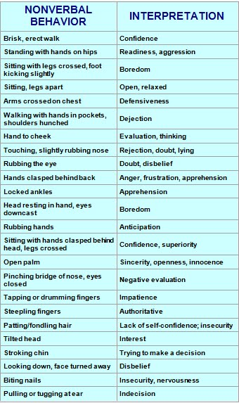

Slide 16
Principles and Functions of Nonverbal Communication
Nonverbal Communication Conveys Important Interpersonal and Emotional Messages
Nonverbal Communication Is More Involuntary than Verbal
Nonverbal Communication Is More Ambiguous
Nonverbal Communication Is More Credible

Slide 17
Functions of Nonverbal Communication
Nonverbal Communication Conveys Meaning
Nonverbal Communication Influences Others
Nonverbal Communication Regulates Conversational Flow
Nonverbal Communication Affects Relationships
Nonverbal Communication Expresses Our Identities

Slide 18
Tips to Perfect Your Nonverbal Communication for Video Calls
Remember you’re being watched
Be mindful of your body language
Put your phone down
Look into the camera
Avoid excessive movements and dramatic hand gestures
Be aware of your facial expressions

